Slide 1
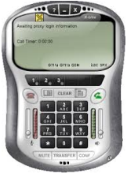
Internet
SIP Endpoint
Eth1 192.168.60.10
Eth0
192.168.50.10
202.65.100.200
IP PBX
SBC
R
ITSP
192.168.60.40
LAN
Port Forwarding
Internet
211.128.90.110
Access network: SIP endpoints register to IPPBX through SBC
Access Trunk: SIP trunk between ITSP and SBC, send and receive calls from ITSP
Core Trunk: SIP trunk between SBC and IP PBX, send and receive calls from IP PBX
A successful call include two sessions
ITSP ---SBC
SBC--- IP PBX
The call flow is
Call to IPPBX: ITSP----SBC----IP PBX, that is Access trunk----SBC ---- IP PBX
Call from IPPBX: IP PBX--- SBC---ITSP, that is Core trunk ---- SBC ---- ITSP

Slide 2
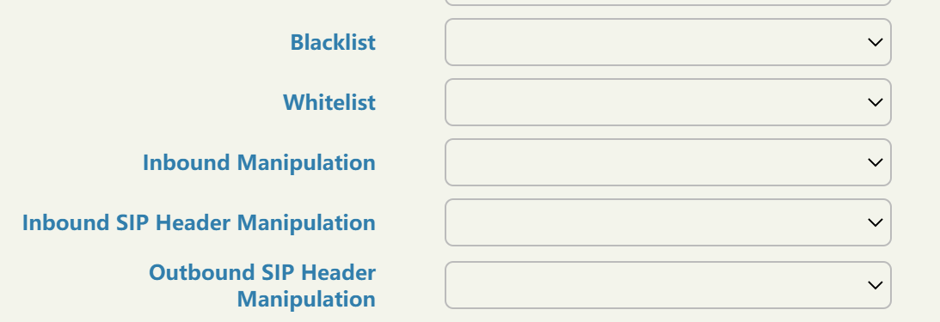
Why SBC is a SIP Firewall?
Call blacklist
Call whitelist
SIP header manipulation
Register source IP/ IP range
Domain filter

Slide 3
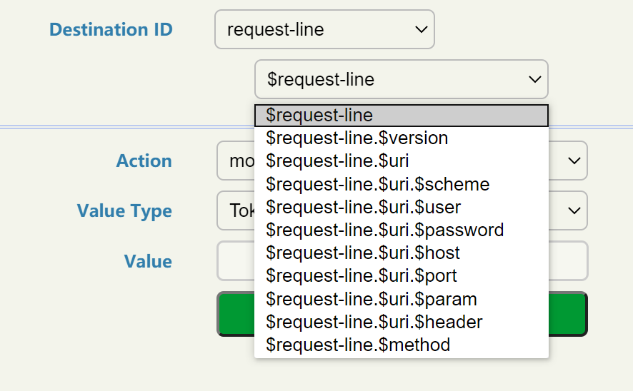
INVITE sip:76644228@10.40.1.145 SIP/2.0
Via: SIP/2.0/UDP 10.40.1.174:5060;branch=z9hG4bK403d8ea0
Max-Forwards: 70
From: "Frutan Central 03" <sip:24619444@10.40.1.174>;tag=as310ce46f
To: <sip:76644228@10.40.1.145>
Contact: <sip:24619444@10.40.1.174:5060>
Call-ID: 07c8205b7da71fd42fb1978d371ee5b0@10.40.1.174:5060
CSeq: 102 INVITE
User-Agent: PBXVirtual.co.cr Asterisk
Date: Wed, 04 Mar 2020 18:42:07 GMT
Allow: INVITE, ACK, CANCEL, OPTIONS, BYE, REFER, SUBSCRIBE, NOTIFY, INFO, PUBLISH, MESSAGE
Supported: replaces, timer
X-Caller-Id: 24619444
Content-Type: application/sdp
Content-Length: 256
v=0
o=root 832062601 832062601 IN IP4 10.40.1.174
s=Asterisk PBX 11.16.0
c=IN IP4 10.40.1.174
t=0 0
m=audio 18076 RTP/AVP 0 8 101
a=rtpmap:0 PCMU/8000
a=rtpmap:8 PCMA/8000
a=rtpmap:101 telephone-event/8000
a=fmtp:101 0-16
a=ptime:20
a=sendrecv
SIP header– request line
Domain Filter

Slide 4
How SBC implement network topology hiding?

Slide 5
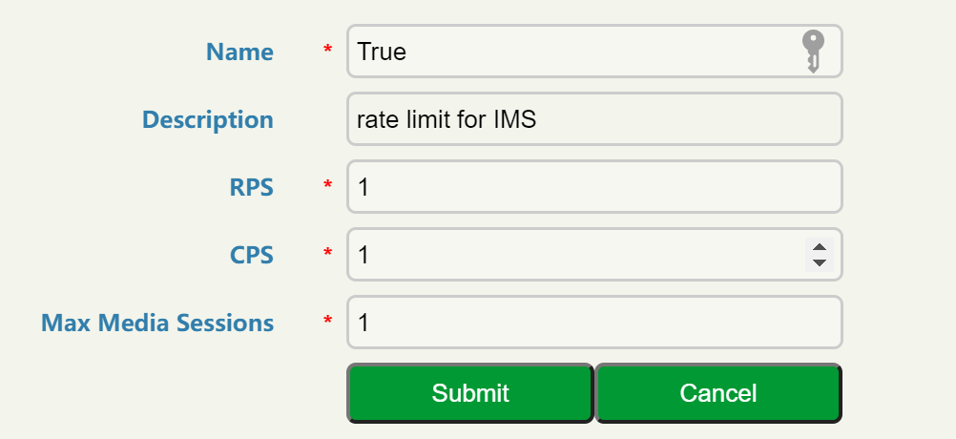
Registration / Call Rate Limiting

Slide 6
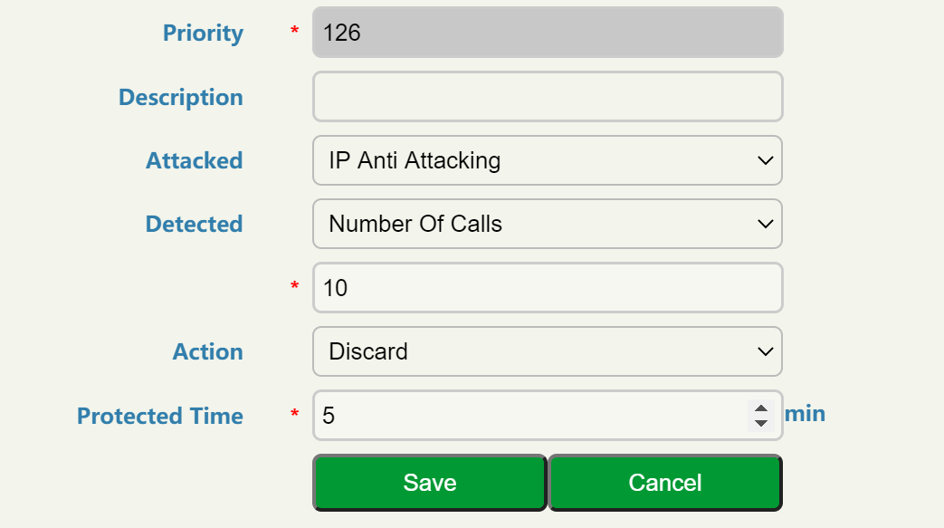
How SBC Anti-attack
DoS/DDoS attack protection
IP Security and SIP security

